Slide 1




CS Bridge, Lecture 10 Animation

Slide 2


Learning Goals
Get more practice writing programs with graphics
Understand how parameters are passed between functions
Write graphics programs with animation

Slide 3
End Goal: Bouncing Ball!

Slide 4
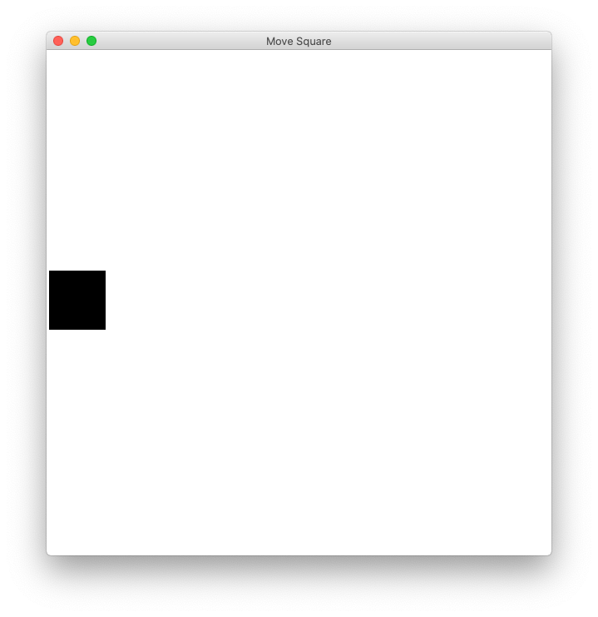
Checkpoint: “Move To Center”

Slide 5
Lecture Plan
Review: Graphics
Animation Loop Structure
Example: Move To Center
Practice: Bouncing Ball
Passing Parameters

Slide 6
Lecture Plan
Review: Graphics
Animation Loop Structure
Example: Move To Center
Practice: Bouncing Ball
Passing Parameters

Slide 7
In our last episode…

Slide 8
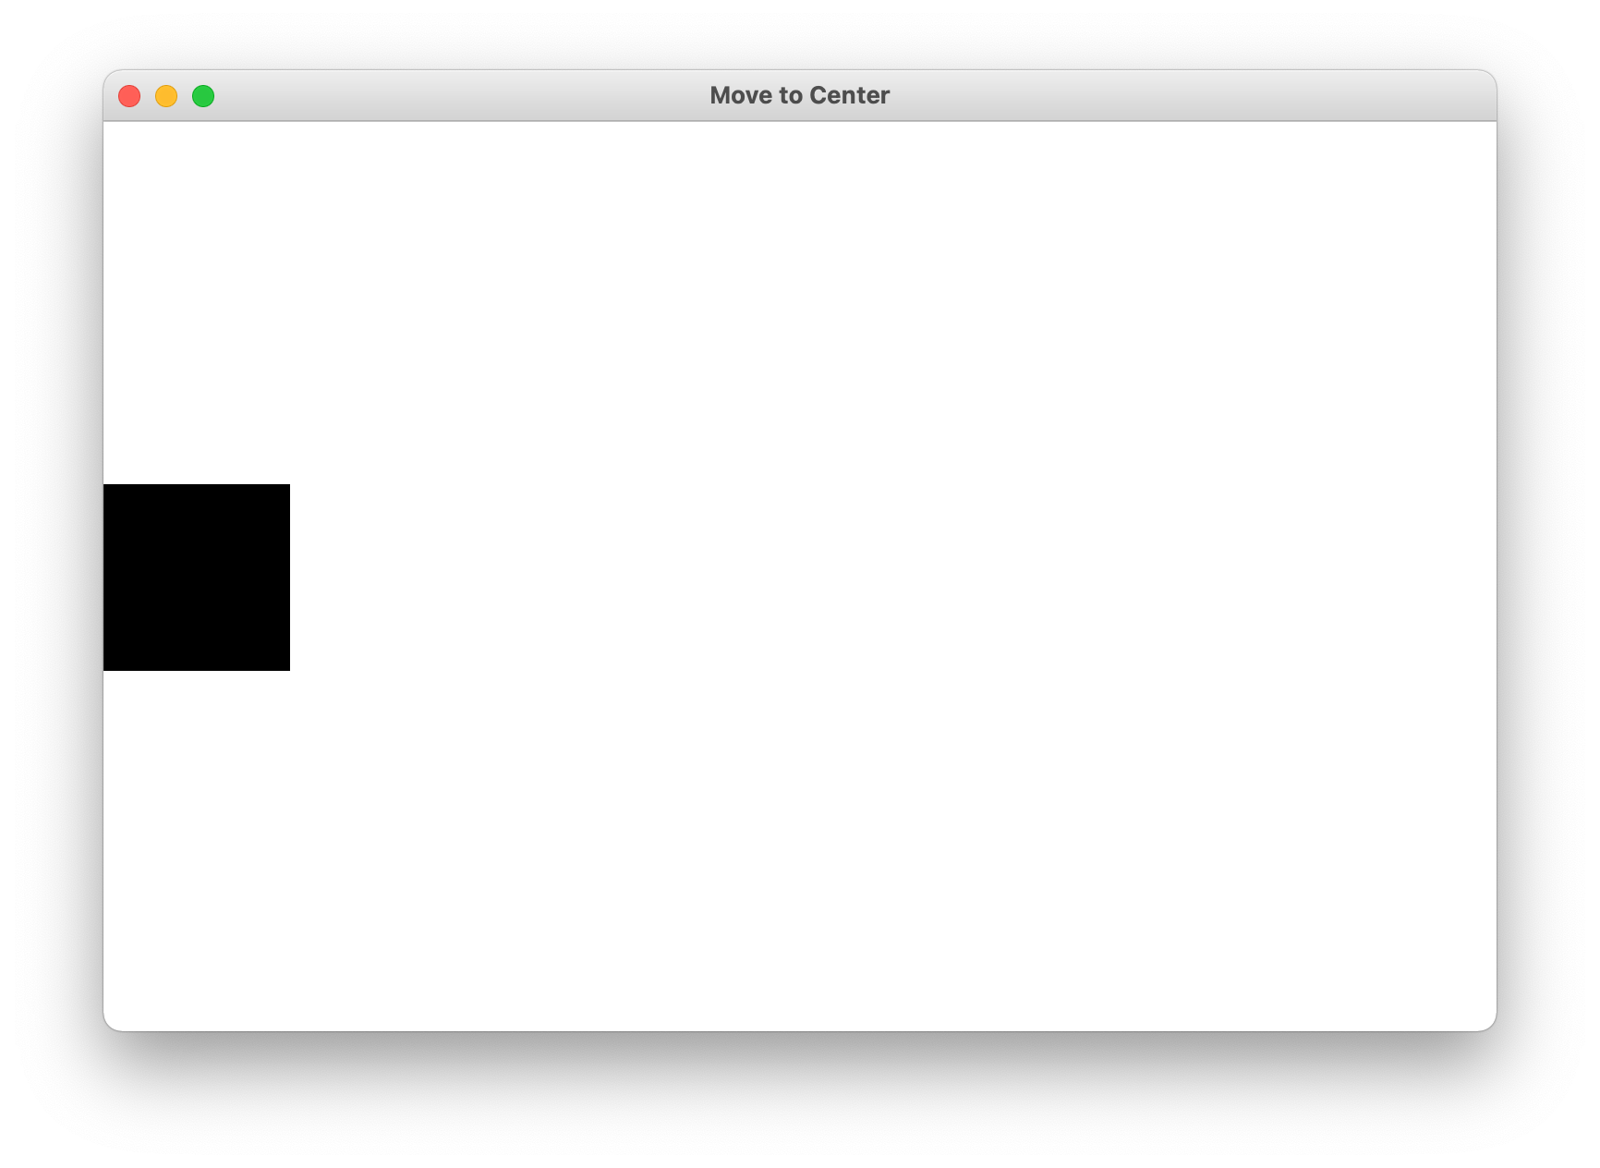
Graphics From Tkinter
from graphics import Canvas

Slide 9
Add Square

Slide 10
Add Square
SQUARE_SIZE = 100
def main():
canvas = Canvas()
canvas.set_canvas_title("Move to Center")
square_top_y = canvas.get_canvas_height() / 2 - SQUARE_SIZE / 2
rect = canvas.create_rectangle(0, square_top_y, SQUARE_SIZE, square_top_y + SQUARE_SIZE)
canvas.set_color(rect, "black")
canvas.mainloop()

Slide 11
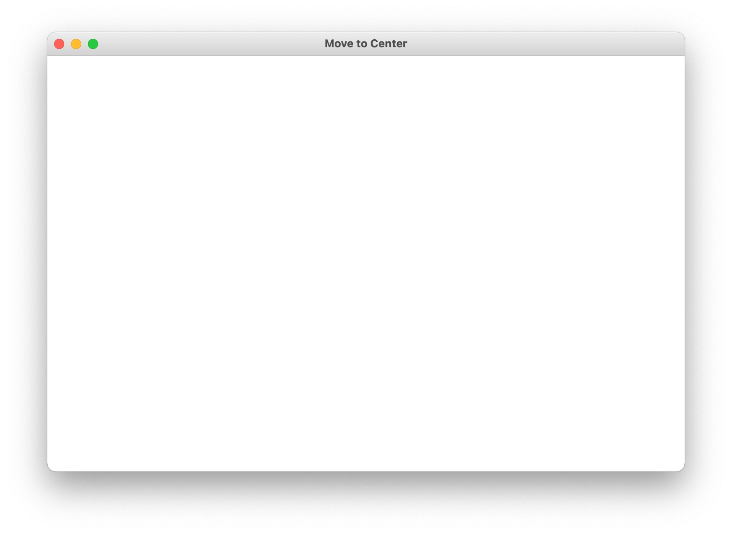
Add Square
canvas = Canvas()
canvas.set_canvas_title("Move to Center")
square_top_y = canvas.get_canvas_height() / 2 - SQUARE_SIZE / 2
rect = canvas.create_rectangle(0, square_top_y, SQUARE_SIZE, square_top_y + SQUARE_SIZE)
canvas.set_color(rect, "black")
canvas.mainloop()

Slide 12
Add Square
canvas = Canvas()
canvas.set_canvas_title("Move to Center")
square_top_y = canvas.get_canvas_height() / 2 - SQUARE_SIZE / 2
rect = canvas.create_rectangle(0, square_top_y, SQUARE_SIZE, square_top_y + SQUARE_SIZE)
canvas.set_color(rect, "black")
canvas.mainloop()
canvas.get_canvas_height() / 2

Slide 13
Add Square
canvas = Canvas()
canvas.set_canvas_title("Move to Center")
square_top_y = canvas.get_canvas_height() / 2 - SQUARE_SIZE / 2
rect = canvas.create_rectangle(0, square_top_y, SQUARE_SIZE, square_top_y + SQUARE_SIZE)
canvas.set_color(rect, "black")
canvas.mainloop()
canvas.get_canvas_height() / 2 – SQUARE_SIZE / 2
canvas.get_canvas_height() / 2

Slide 14
Add Square
canvas = Canvas()
canvas.set_canvas_title("Move to Center")
square_top_y = canvas.get_canvas_height() / 2 - SQUARE_SIZE / 2
rect = canvas.create_rectangle(0, square_top_y, SQUARE_SIZE, square_top_y + SQUARE_SIZE)
canvas.set_color(rect, "black")
canvas.mainloop()
square_top_y
square_top_y + SQUARE_SIZE

Slide 15
Add Square
canvas = Canvas()
canvas.set_canvas_title("Move to Center")
square_top_y = canvas.get_canvas_height() / 2 - SQUARE_SIZE / 2
rect = canvas.create_rectangle(0, square_top_y, SQUARE_SIZE, square_top_y + SQUARE_SIZE)
canvas.set_color(rect, "black")
canvas.mainloop()
(0, square_top_y)
(SQUARE_SIZE, square_top_y + SQUARE_SIZE)

Slide 16
Add Square
canvas = Canvas()
canvas.set_canvas_title("Move to Center")
square_top_y = canvas.get_canvas_height() / 2 - SQUARE_SIZE / 2
rect = canvas.create_rectangle(0, square_top_y, SQUARE_SIZE, square_top_y + SQUARE_SIZE)
canvas.set_color(rect, "black")
canvas.mainloop()

Slide 17
Add Square
canvas = Canvas()
canvas.set_canvas_title("Move to Center")
square_top_y = canvas.get_canvas_height() / 2 - SQUARE_SIZE / 2
rect = canvas.create_rectangle(0, square_top_y, SQUARE_SIZE, square_top_y + SQUARE_SIZE)
canvas.set_color(rect, "black")
canvas.mainloop()

Slide 18
End of review!

Slide 19
Lecture Plan
Review: Graphics
Animation Loop Structure
Example: Move To Center
Practice: Bouncing Ball
Passing Parameters

Slide 20
How do movies or games animate?

Slide 21
Checkpoint: “Move To Center”

Slide 22
Animation Loop
def main():
# setup done once
while ???:
# update world
# pause
time.sleep(PAUSE_SECONDS)
canvas.mainloop()

Slide 23
Animation Loop
def main():
# setup done once
while ???:
# update world
# pause
time.sleep(PAUSE_SECONDS)
canvas.mainloop()
Make all the variables you need.

Slide 24
Animation Loop
def main():
# setup done once
while ???:
# update world
# pause
time.sleep(PAUSE_SECONDS)
canvas.mainloop()
The animation loop is a repetition of heartbeats, either forever (while True) or until some condition is no longer true.

Slide 25
Animation Loop
def main():
# setup done once
while ???:
# update world
# pause
time.sleep(PAUSE_SECONDS)
canvas.mainloop()
Each heart-beat, update the world forward one frame

Slide 26
Animation Loop
def main():
# setup done once
while ???:
# update world
# pause
time.sleep(PAUSE_SECONDS)
canvas.mainloop()
If you don’t pause, humans won’t be able to see it!

Slide 27
Animation Loop
def main():
# setup done once
while ???:
# update world
# pause
time.sleep(PAUSE_SECONDS)
canvas.mainloop()
Make sure to call mainloop() to make your program run correctly.

Slide 28
Lecture Plan
Review: Graphics
Animation Loop Structure
Example: Move To Center
Practice: Bouncing Ball
Passing Parameters

Slide 29
Checkpoint: “Move To Center”

Slide 30
Animation Loop
def main():
# setup done once
while ???:
# update world
# pause
time.sleep(PAUSE_SECONDS)
canvas.mainloop()

Slide 31
Animation Loop
def main():
# setup done once
canvas = Canvas()
canvas.set_canvas_title("Move to Center")
square_top_y = canvas.get_canvas_height() / 2 - SQUARE_SIZE / 2
rect = canvas.create_rectangle(0, square_top_y, SQUARE_SIZE, square_top_y + SQUARE_SIZE)
canvas.set_color(rect, "black")
while ???:
# update world
# pause
time.sleep(PAUSE_SECONDS)
canvas.mainloop()

Slide 32
Animation Loop
def main():
# setup done once
canvas = Canvas()
canvas.set_canvas_title("Move to Center")
square_top_y = canvas.get_canvas_height() / 2 - SQUARE_SIZE / 2
rect = canvas.create_rectangle(0, square_top_y, SQUARE_SIZE, square_top_y + SQUARE_SIZE)
canvas.set_color(rect, "black")
while ???:
# update world
canvas.move(rect, 1, 0)
canvas.update()
# pause
time.sleep(PAUSE_SECONDS)
canvas.mainloop()

Slide 33
Animation Loop
def main():
# setup done once
canvas = Canvas()
canvas.set_canvas_title("Move to Center")
square_top_y = canvas.get_canvas_height() / 2 - SQUARE_SIZE / 2
rect = canvas.create_rectangle(0, square_top_y, SQUARE_SIZE, square_top_y + SQUARE_SIZE)
canvas.set_color(rect, "black")
while ???:
# update world
canvas.move(rect, 1, 0)
canvas.update()
# pause
time.sleep(PAUSE_SECONDS)
canvas.mainloop()
Tells the canvas to update the screen. Don’t forget this! Call it once you are finished making all canvas changes for now.

Slide 34
Animation Loop
def main():
# setup done once
canvas = Canvas()
canvas.set_canvas_title("Move to Center")
square_top_y = canvas.get_canvas_height() / 2 - SQUARE_SIZE / 2
rect = canvas.create_rectangle(0, square_top_y, SQUARE_SIZE, square_top_y + SQUARE_SIZE)
canvas.set_color(rect, "black")
while ???:
# update world
canvas.move(rect, 1, 0)
canvas.update()
# pause
time.sleep(PAUSE_SECONDS)
canvas.mainloop()
When do we want to stop the animation loop?

Slide 35
Let’s live code!

Slide 36
Move to Center
def main():
# setup done once
canvas = Canvas()
canvas.set_canvas_title("Move to Center")
square_top_y = canvas.get_canvas_height() / 2 - SQUARE_SIZE / 2
rect = canvas.create_rectangle(0, square_top_y, SQUARE_SIZE, square_top_y + SQUARE_SIZE)
canvas.set_color(rect, "black")
while is_not_past_center(canvas, rect):
# update world
canvas.move(rect, 1, 0)
canvas.update()
# pause
time.sleep(PAUSE_SECONDS)
canvas.mainloop()

Slide 37
More Helpful Graphics Functions
canvas.move(obj, dx, dy) | Moves obj using the displacements dx and dy.
canvas.moveto(obj, x, y) | Sets the location of obj to the specified coordinates.
# move shape to some new coordinates
canvas.moveto(shape, new_x, new_y)
# move shape by a given change_x and change_y
canvas.move(shape, change_x, change_y)

Slide 38
We are ready...

Slide 39
Lecture Plan
Review: Graphics
Animation Loop Structure
Example: Move To Center
Practice: Bouncing Ball
Passing Parameters

Slide 40
Bouncing Ball

Slide 41
Bouncing Ball: Milestone 1 - Movement

Slide 42
Bouncing Ball
First heartbeat
Key variable: how much the ball position
change each heartbeat?

Slide 43
Bouncing Ball
First heartbeat
change_x
change_y
The move function takes in
a change in x and a change in y

Slide 44
Bouncing Ball
Second heartbeat
change_x
change_y

Slide 45
Bouncing Ball
Third heartbeat
change_x
change_y

Slide 46
Bouncing Ball
What happens when we hit a wall?

Slide 47
Bouncing Ball
We have this velocity
change_x
change_y

Slide 48
Bouncing Ball
Our new velocity
change_y
change_x
When reflecting vertically: change_y = -change_y

Slide 49
Bouncing Ball
Seventh heartbeat
change_y
change_x

Slide 50
Bouncing Ball
Eighth heartbeat
change_y
change_x

Slide 51
Bouncing Ball
Ninth heartbeat
change_y
change_x

Slide 52
Bouncing Ball
We want this!

Slide 53
Bouncing Ball
This was our old velocity
change_y
change_x

Slide 54
Bouncing Ball
This is our new velocity
change_y
change_x
When reflecting horizontally: change_x = -change_x

Slide 55
Bouncing Ball
Tenth heartbeat
change_y
change_x
When reflecting horizontally: change_x = -change_x

Slide 56
Bouncing Ball

Slide 57
Let’s write some code!

Slide 58
Wait a minute….
def make_ball(canvas):
Does this copy the canvas??!!
Variables are stored using a reference. Which is like a URL. The URL gets copied when you pass the variable

Slide 59
Lecture Plan
Review: Graphics
Animation Loop Structure
Example: Move To Center
Practice: Bouncing Ball
Passing Parameters

Slide 60
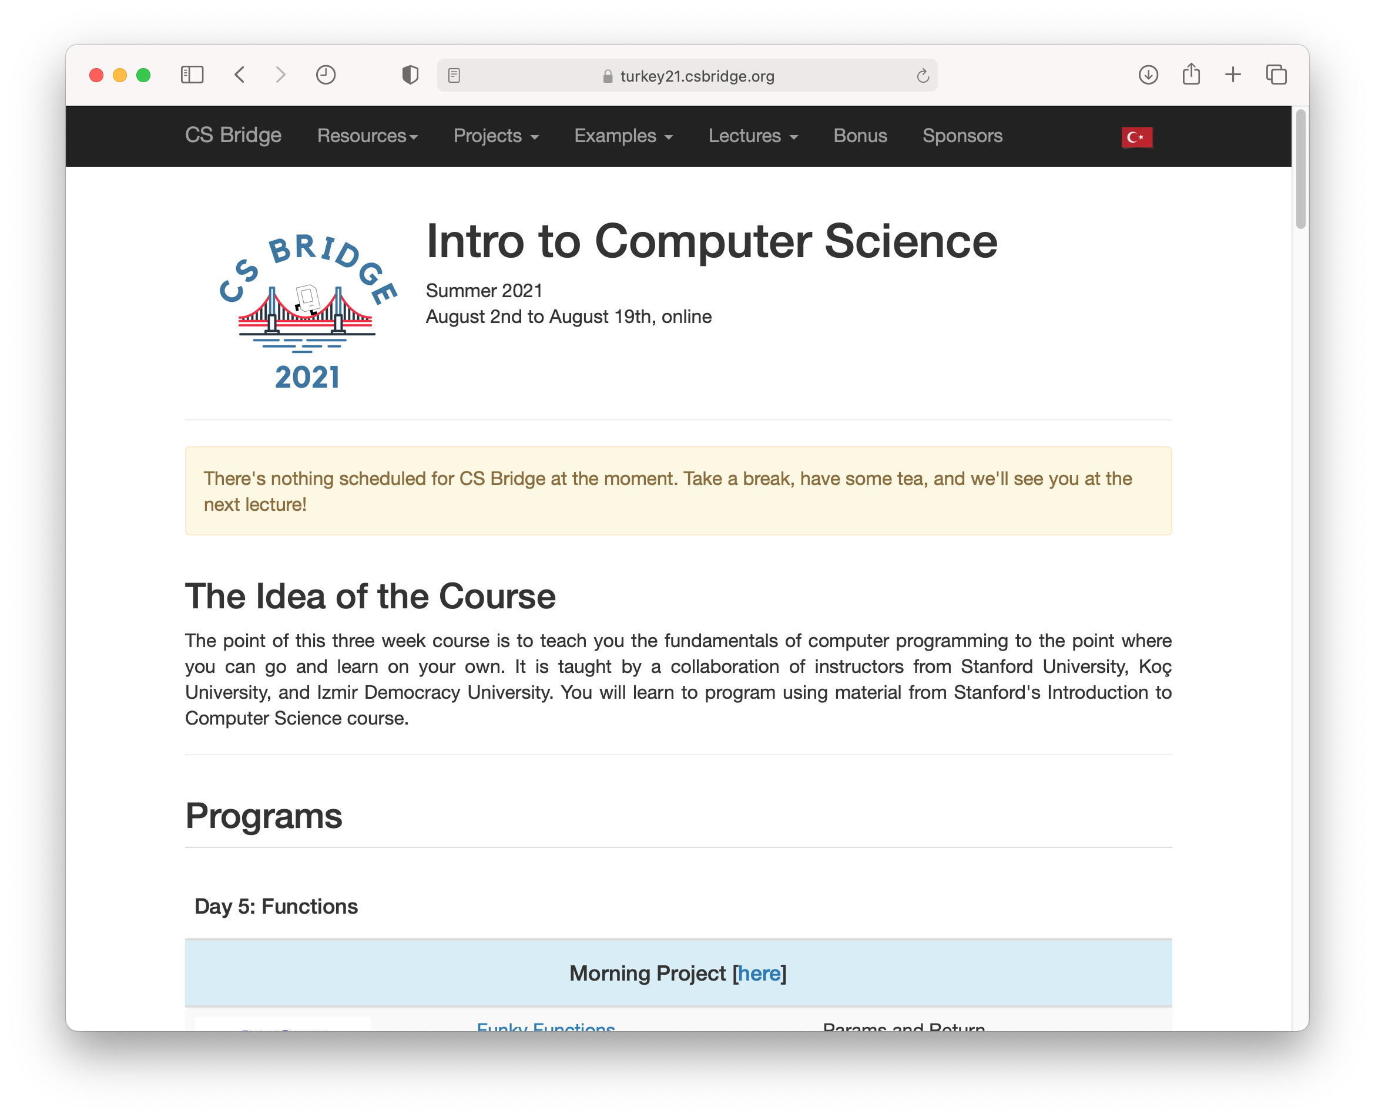
How do we share websites?
turkey21.csbridge.org

Slide 61
Passing Parameters
def main():
canvas = Canvas()
make_ball(canvas)
def make_ball(canvas):
canvas.create_oval( … )
stack
heap
main

Slide 62
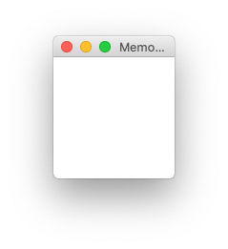
Passing Parameters
def main():
canvas = Canvas()
make_ball(canvas)
def make_ball(canvas):
canvas.create_oval( … )
stack
heap
memory.com/42
main
memory.com/42
canvas

Slide 63
Passing Parameters
def main():
canvas = Canvas()
make_ball(canvas)
def make_ball(canvas):
canvas.create_oval( … )
stack
heap
memory.com/42
main
canvas
42

Slide 64
Passing Parameters
def main():
canvas = Canvas()
make_ball(canvas)
def make_ball(canvas):
canvas.create_oval( … )
stack
heap
memory.com/42
main
canvas
42
make_ball
canvas

Slide 65
Passing Parameters
def main():
canvas = Canvas()
make_ball(canvas)
def make_ball(canvas):
canvas.create_oval( … )
stack
heap
memory.com/42
main
canvas
42
make_ball
canvas
42

Slide 66
Passing Parameters
def main():
canvas = Canvas()
make_ball(canvas)
def make_ball(canvas):
canvas.create_oval( … )
stack
heap
memory.com/42
main
canvas
42
make_ball
canvas
42

Slide 67
Passing Parameters
def main():
canvas = Canvas()
make_ball(canvas)
def make_ball(canvas):
canvas.create_oval( … )
stack
heap
memory.com/42
main
canvas
42
make_ball
canvas
42

Slide 68
Passing Parameters
def main():
canvas = Canvas()
make_ball(canvas)
def make_ball(canvas):
canvas.create_oval( … )
stack
heap
memory.com/42
main
canvas
42

Slide 69
Key Idea: Passing Parameters
When passing variables, some act just like you are passing a URL.
That allows functions to modify the variable

Slide 70
Lecture Plan
Review: Graphics
Animation Loop Structure
Example: Move To Center
Practice: Bouncing Ball
Passing Parameters

Slide 71
Coming soon…

Slide 72
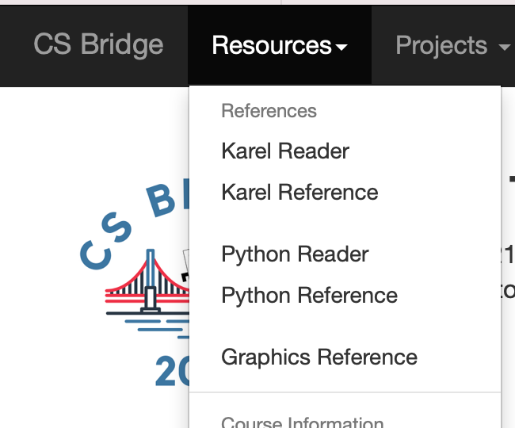
Graphics Resources

Slide 73

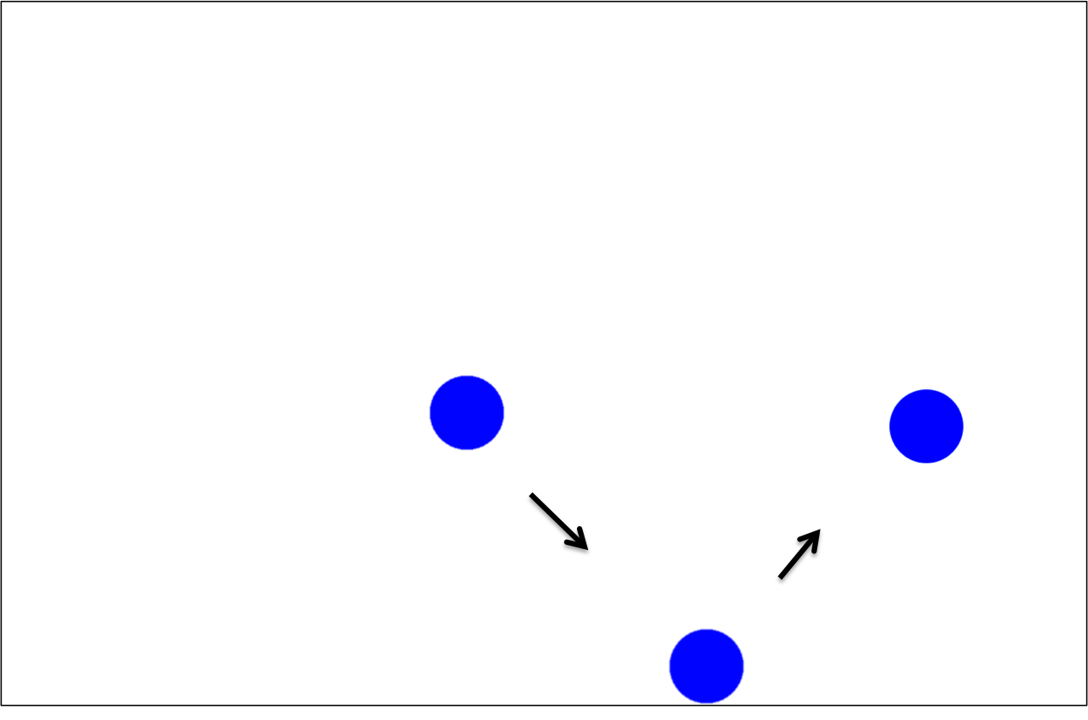
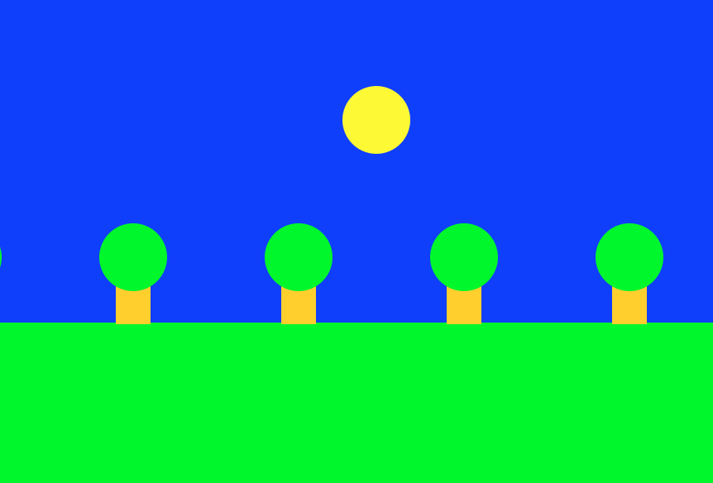
Rest Of Today
Quickstart: Program a mystery square… (???)
Section: Complete the implementation of the bouncing ball program
Project: Use animation to create your own short film!

Slide 74
What’s Next?
Time for your section’s quickstart time!
Check your section’s Ed group for more information

